Slide 1
Around the World Coverage Classifying the Differences in News Coverage of the Hong Kong Protests
Michael Siebel
Junchi Tian
Bixuan Huang

Slide 2


Background
This summer, protests broke out in Hong Kong, at first related to an extradition treaty that the protesters viewed as an encroachment of mainland China into the special administrative region of Hong Kong.
U.S. and Chinese newspapers largely take a different view on these protests.
Can we build a model that will understand these differences?

Slide 3
Overview
Figuring out different journalistic tones between U.S. newspapers and Chinese newspapers could help us get better understanding of U.S. and Chinese commend view points about Hong Kong Protest.
Our goal is to determine what natural language processing (NLP) techniques can best distinguish between U.S. and Chinese reporting on the 2019 Hong Kong protests.
Process:
Pre-processing
Exploratory Data Analysis
Modelling
Assessment

Slide 4


Corpus
1,101 news articles on the Hong Kong protests; 552 were from U.S. newspapers and 549 were from Chinese newspapers.
U.S. newspapers included the Wall Street Journal, Washington Post, and New York Times.
Chinese newspapers included China Daily, People’s Daily, and Xinhua Agent.
We use web Scraper to scrape corpus from ProQuest.

Slide 5
Data Preprocessing Steps
Tokenized words
Removed punctuation and numbers
Set words to lowercase
Stemmed words
Removed stop words
Split into training and testing
Prepared for a Bag of Words (BoW) modeling

Slide 6
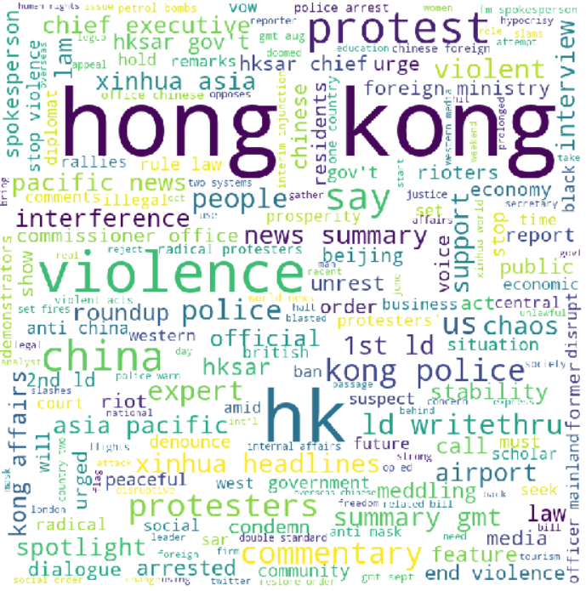
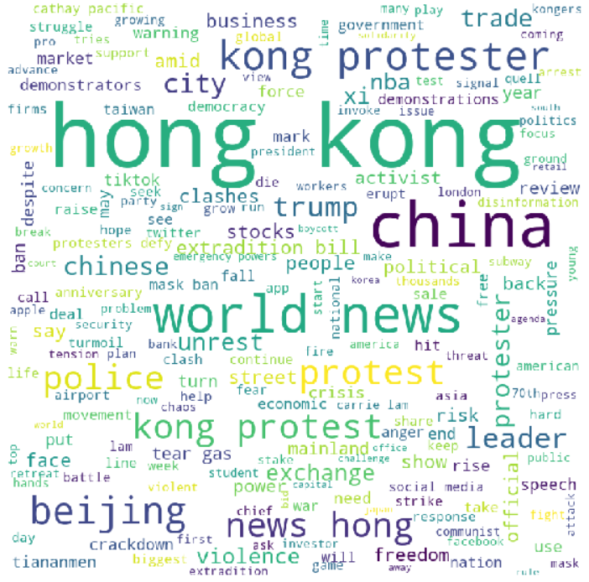
Word Cloud
China
U.S.

Slide 7
Word Frequency
 | Chinese Newspapers |  | U.S. Newspapers
 | Word | Freq | Word | Freq
0 | hong | 5721 | hong | 6067
1 | kong | 5674 | kong | 5825
2 | said | 2859 | protest | 4575
3 | polic | 2015 | said | 3601
4 | protest | 1954 | china | 3525
5 | govern | 1340 | chines | 2245
6 | peopl | 1299 | polic | 2171
7 | china | 1289 | peopl | 1720
8 | violenc | 1098 | beij | 1645
9 | law | 1046 | govern | 1613
 | Chinese Newspapers |  | U.S. Newspapers
 | Word | Freq | Word | Freq
10 | violent | 945 | would | 1451
11 | offic | 784 | one | 1296
12 | citi | 703 | citi | 1234
13 | public | 682 | year | 1044
14 | countri | 670 | polit | 956
15 | chines | 651 | demonstr | 955
16 | one | 617 | mainland | 894
17 | hksar | 546 | time | 861
18 | Two | 538 | use | 845
19 | Act | 537 | lam | 830

Slide 8
TF-IDF
 | Chinese Newspapers |  | U.S. Newspapers
 | Word | Weight | Word | Weight
0 | said | 0.087133 | said | 0.075097
1 | polic | 0.063606 | police | 0.064404
2 | china | 0.049195 | protesters | 0.057372
3 | govern | 0.040110 | chinese | 0.050596
4 | law | 0.040074 | mr | 0.046603
5 | ha | 0.039674 | beijing | 0.046157
6 | violent | 0.035292 | people | 0.039267
7 | wa | 0.032080 | government | 0.037620
8 | violenc | 0.031111 | city | 0.035355
9 | peopl | 0.031015 | lam | 0.032596
 | Chinese Newspapers |  | U.S. Newspapers
 | Word | Weight | Word | Weight
10 | hksar | 0.028894 | trump | 0.028166
11 | public | 0.028253 | mainland | 0.025260
12 | offic | 0.028036 | xi | 0.024914
13 | airport | 0.026426 | party | 0.023303
14 | chines | 0.026026 | democracy | 0.023188
15 | lam | 0.025312 | trade | 0.022204
16 | intern | 0.025171 | law | 0.021734
17 | sar | 0.023906 | political | 0.020953
18 | order | 0.023900 | year | 0.020823
19 | act | 0.023037 | pro | 0.019826

Slide 9
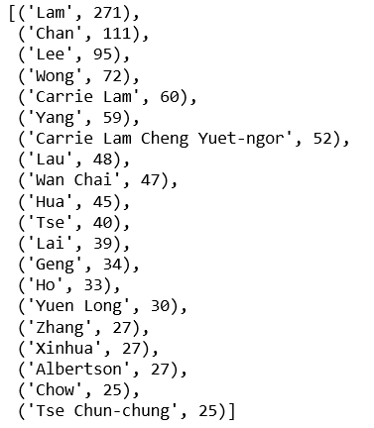
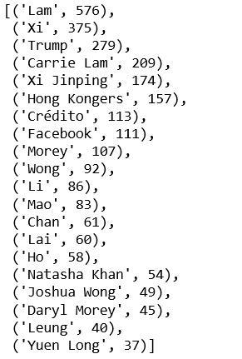
Information Extraction - Persons
China
U.S.

Slide 10
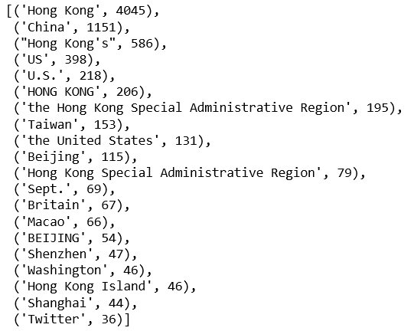
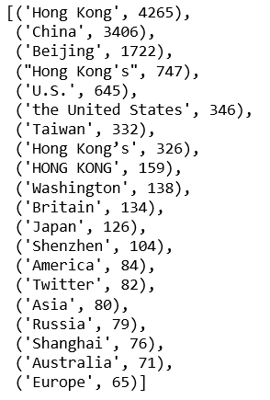
Information Extraction - Locations
China
U.S.

Slide 11
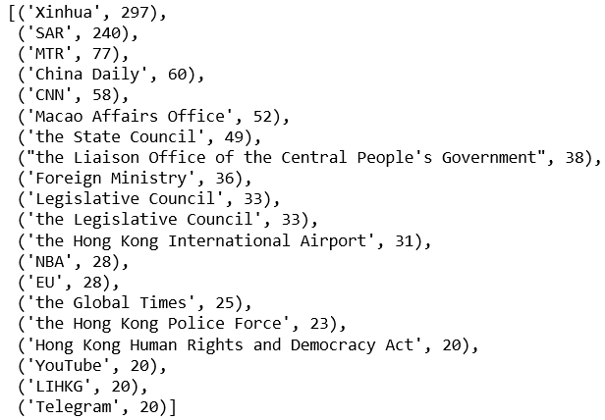
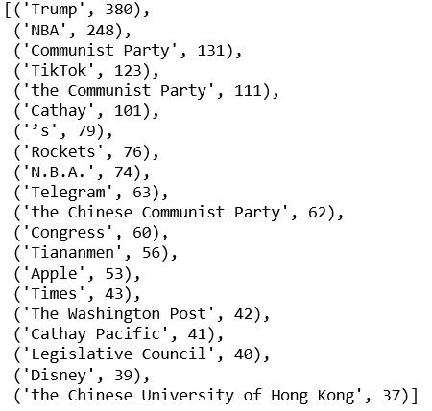
Information Extraction - Organizations
China
U.S.

Slide 12
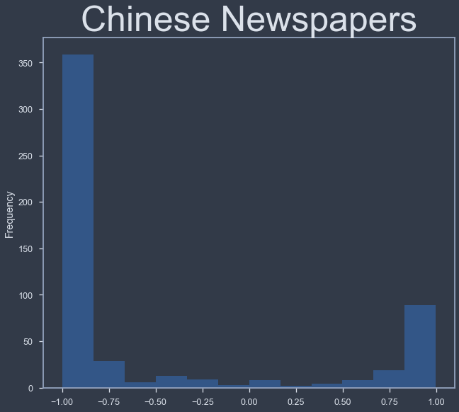
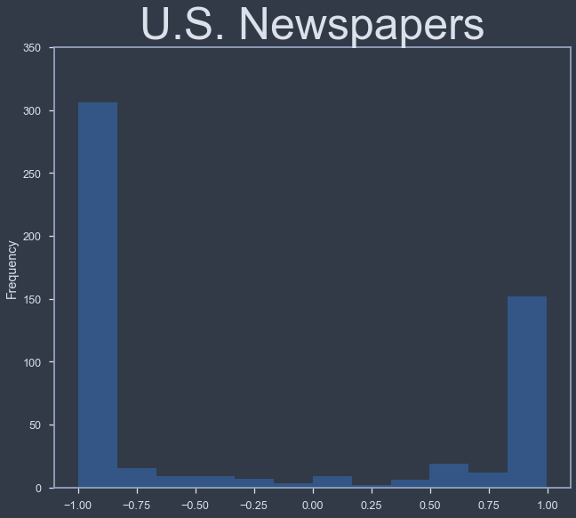
Sentiment analysis (by rule-based sentiment analysis engine VADER)
Chinese newspapers are largely more negative, which is expected as we expect Chinese newspapers to focus more on the chaos created from the protests.
Chinese newspapers contained a mean score of -0.51 and U.S. newspapers contained a mean score of -0.28, on a scale of -1 to 1.

Slide 13
Cosine Similarity
Chinese newspapers: 0.64-0.72.
This suggests that they are fairly similar to each other, except for China Daily and Xinhua being somewhat different.
U.S. newspapers: 0.62-0.63.
The difference might be due to the wider range of topics and issues U.S. newspapers seem interested in discussing.
More importantly,
Chinese and U.S. newspapers contain a substantively lower cosine similarity of 0.55, indicating that they are quite different.

Slide 14
Modeling
We ran a total of 27 models, in which we varied three parameters: the minimum sparsity threshold, the term weights, and the n-grams
Parameters | Variations
Minimum sparsity | 1% threshold | 5% threshold | 10% threshold
Term weights | Binary occurrence | TF | TF-IDF
N-grams | Unigram | Bigram | Trigram

Slide 15
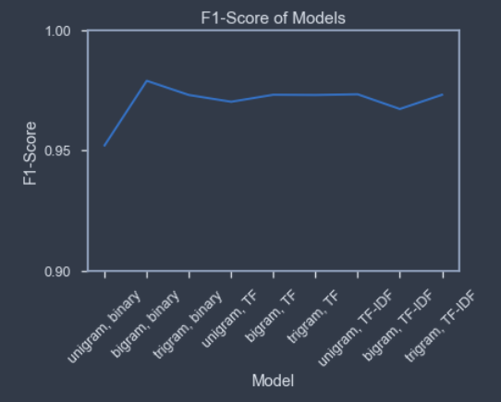
Modeling
We evaluated our models based on their F1-scores.
A 1% minimum sparsity threshold proved better than a 5% or 10%, but only by a little.
With a 1% minimum sparsity threshold—all containing similar F1-scores ranging from 0.955 to 0.979.

Slide 16
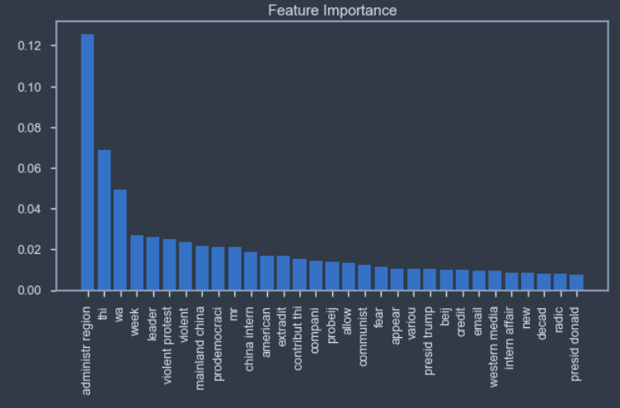
Modeling
Our best model configuration included an F1-score of 0.979
On our test set, comprise of 331 news articles (30% of our corpus)
7 misclassifications
3 false positives
4 false negatives.
Notable words in the model include: administrative region, violent protest, violent, China internal, internal affair, and radical

Slide 17
Conclusion
Chinese newspapers
pay more attention to HK government and violence
tend to talk about narrow specific events and did not link the protest story to wider global politics
US newspapers
pay more attention to wider issues and democracy
tend to use the head of country to represent each country
contained more variety because they linked the protest story to wider US-China relations and global politics.
The similarity between Chinese newspapers is high which likely improves our ability to distinguish it from U.S. newspapers
As a result:
The model configurations did not make much difference

Slide 18
Bibliography
Brownlee, J. (2017). A gentle introduction to the bag-of-words model. Retrieved from https://machinelearningmastery.com/gentle-introduction-bag-words-model/
Çano, E., and Maurizio, M. (2019.) Word embeddings for sentiment analysis: A comprehensive empirical survey. ArXiv abs/1902.00753.
Satapathy, R., Guerreiro, C., Chaturvedi, I., and Cambria, E. (2017). Phonetic-based microtext normalization for twitter sentiment analysis. In 2017 IEEE International Conference on Data Mining Workshops (ICDMW). IEEE: 407-413.
Silge, J., and Robinson, D. (2018). Analyzing word and document frequency: TF-IDF. In Text Mining with R: A Tidy Approach. Retrieved from https://www.tidytextmining.com/tfidf.html

Slide 19
Thank you

